Slide 1

Introduction to Phishing
Attackers try to trick people into giving away sensitive information.
They pretend to be a trustworthy source, often through fake emails or websites.
mahaveer choudhary

Slide 2
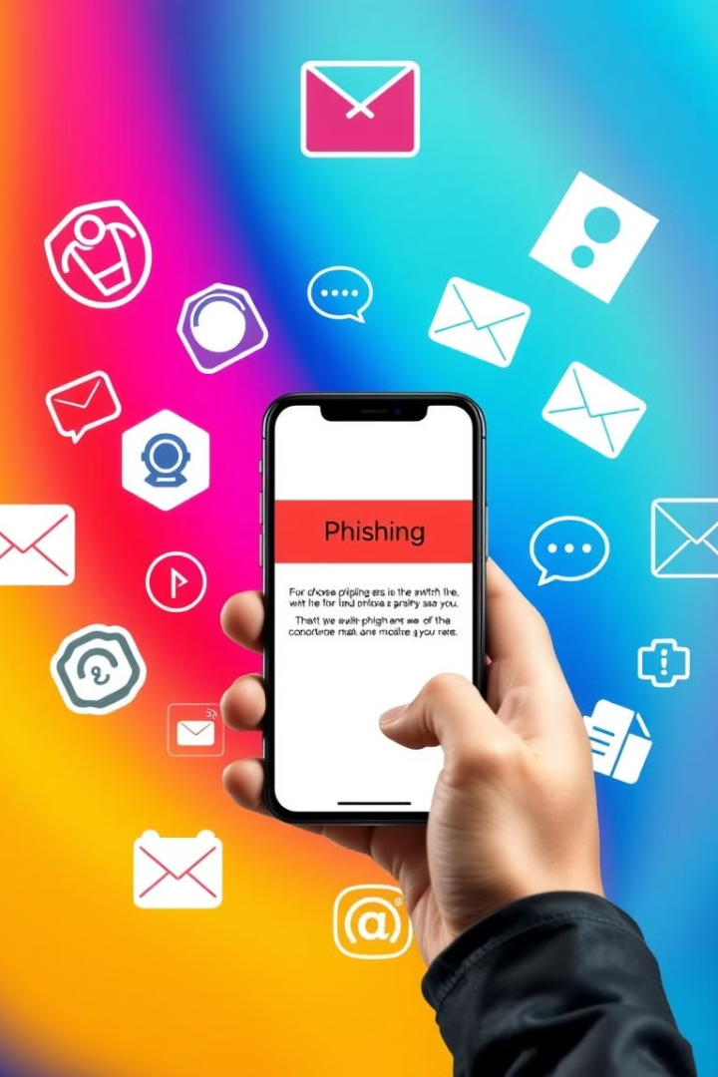
Types of Phishing Attacks
1
Deceptive Phishing
General scams targeting a wide audience.
2
Spear Phishing
Targeted attacks on specific individuals or organizations.
3
Whaling
Phishing attacks aimed at high-profile targets.
4
Vishing & Smishing
Voice phishing over the phone and phishing via SMS messages.

Slide 3
Phishing Techniques
Malicious Links
Malicious Attachments
Fraudulent Data Entry Forms
Redirect users to fake websites or sites infected with malware.
Infected files disguised as legitimate documents.
Fake forms prompting users to provide sensitive information.

Slide 4
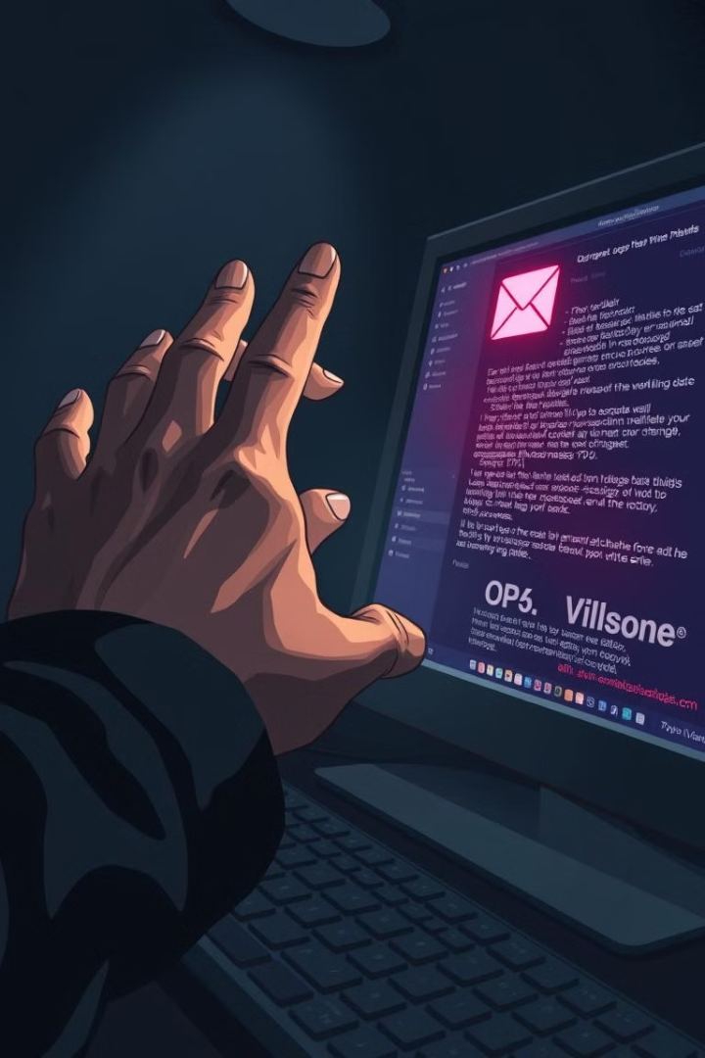




How Phishing Works
The Bait
Attackers create a fake email or message.
The Hook
The message usually contains a sense of urgency.
The Trap
You’re taken to a fake website that looks real.
The Theft
Attackers capture your information.

Slide 5

Recognizing Phishing Attempts
Generic Greetings
Urgent Requests
Poor grammar and suspicious links.
For personal information or to click on links.
Suspicious Links
Account Suspension
Do not match the purported sender.
Requests to verify account details.

Slide 6
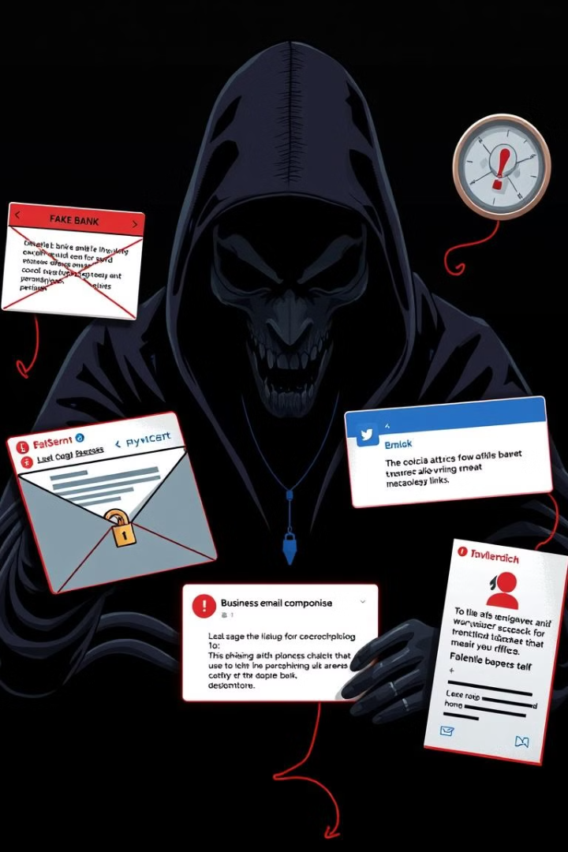
Real-World Examples of Phishing
Bank Phishing
Fake emails from banks requesting verification of account information.
Social Media Scams
Messages from friends or contacts containing malicious links.
Business Email Compromise (BEC)
Attacks targeting organizations to trick employees into transferring funds or sensitive data.

Slide 7
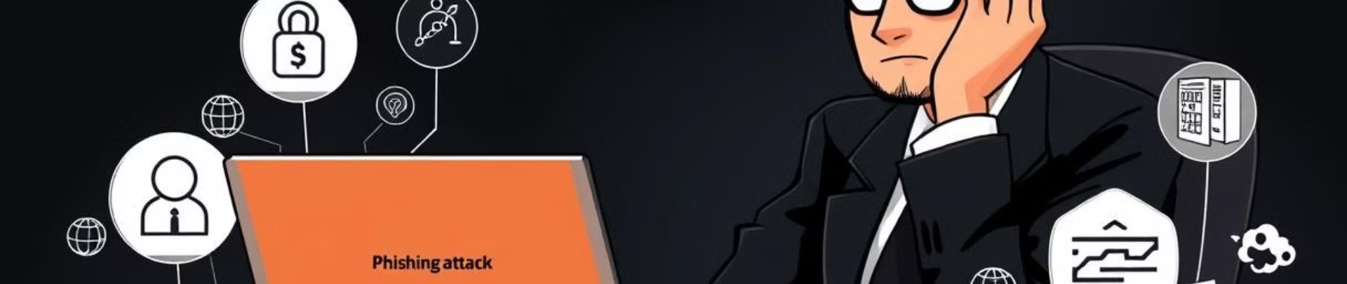




What Happens If You Fall for Phishing?
Identity Theft
Money Loss
Data Breaches
Business Problems
Someone might steal your personal information.
You could lose money from your bank account or credit cards.
Important information can be stolen.
Companies can face legal issues and lose customers' trust.

Slide 8
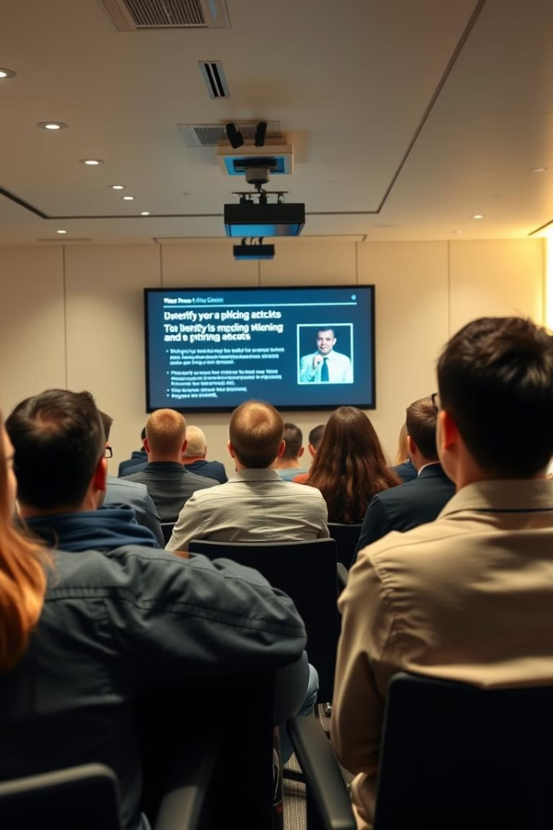
Prevention Strategies
1
Cybersecurity Awareness Training
Educating employees on recognizing phishing attempts.
2
Multi-Factor Authentication (MFA)
Adding an extra layer of security to accounts.
3
Regular Security Updates
Keeping software and systems up to date.

Slide 9
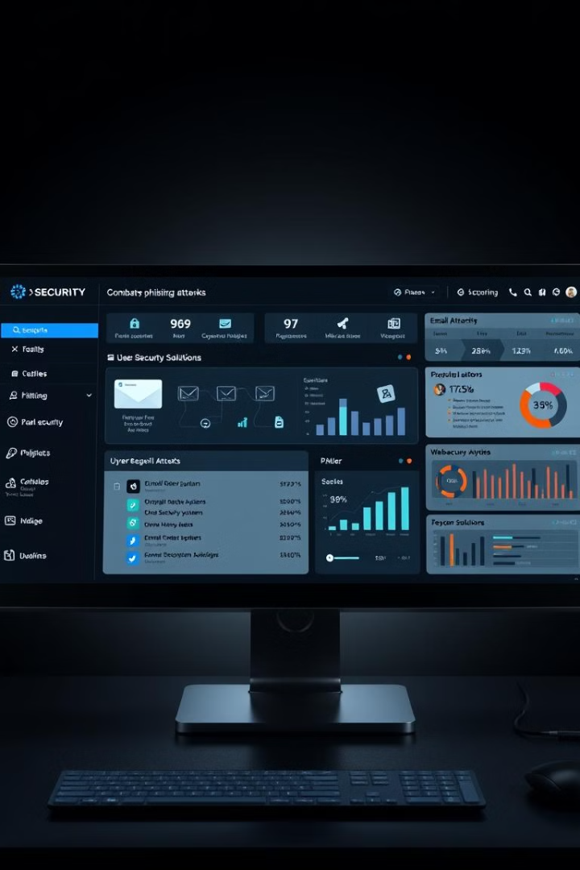
Tools and Technologies for Protection
1
Email Filters
To detect and block phishing emails.
2
Web Security Solutions
To prevent access to malicious websites.
3
User Behavior Monitoring
To identify suspicious activities and potential phishing attempts.

Slide 10

Conclusion and Best Practices
Phishing remains a prevalent threat in the digital landscape.
To protect against phishing attacks, individuals and organizations must stay informed and vigilant.

